Slide 1

הרצאה 3
Compiler II
מעבדה במחשבים מחומרה לתוכנה
קורס 10083
אריק גיספאן arikgi@post.jce.ac.il

Slide 2
Where we are at:
Human
Abstract design
Software
Thought
abstract interface
hierarchy
Chapters 9, 12
H.L. Language
Compiler
&
abstract interface
Operating Sys.
Chapters 10 - 11
Virtual
VM Translator
Machine
abstract interface
Chapters 7 - 8
Assembly
Language
Assembler
Chapter 6
abstract interface
Computer
Machine
Architecture
Language
abstract interface
Chapters 4 - 5
Gate Logic
Hardware
abstract interface
Platform
Chapters 1 - 3
Electrical
Hardware
Chips &
Engineering
Logic Gates
Physics
hierarchy

Slide 3
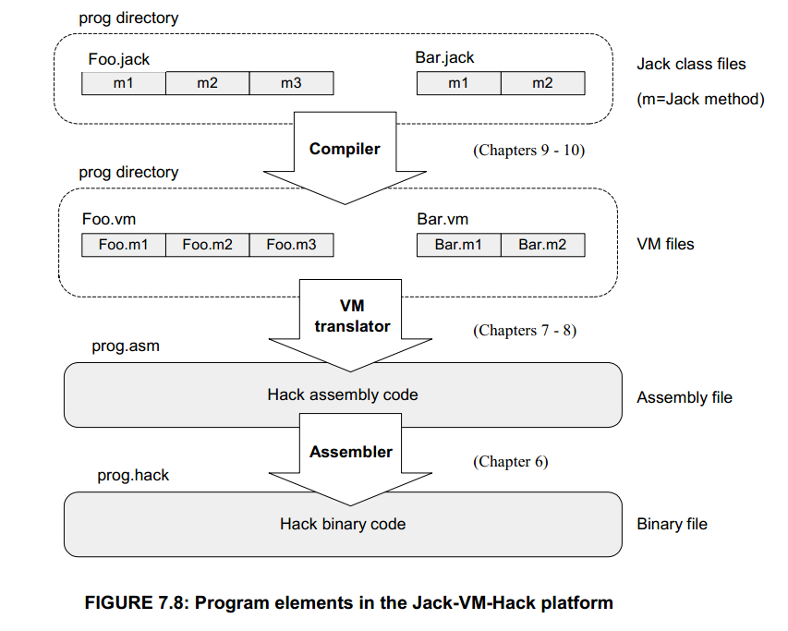
שלבי הקומפילציה

Slide 4
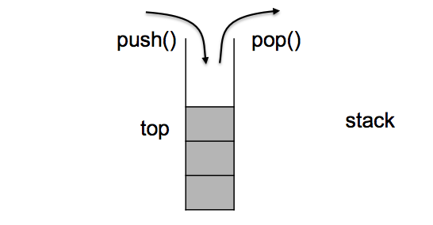
VM language
שפת הביניים אינה תלויה לא בשפת תכנות ולא במכונה
בסיס שפת הביניים - מבנה נתונים של מחסנית
הגישה לזיכרון היא דרך חלוקה לסגמנטים
מספר פקודות מצומצם : 9 אריתמטיות, 2 מחסנית, 3 זרימה ו3 פונקציות

Slide 5
VM language commands
Goal: Specify and implement a VM model and language
Arithmetic / Boolean commands
add
sub
neg
eq
gt
lt
and
or
not
Memory access commands
pop x (variable)
push y (variable or constant)
Program flow commands
label (declaration)
goto (label)
if-goto (label)
Function calling commands
function (declaration)
call (a function)
return (from a function)

Slide 6
Memory access commands
Command format:
pop segment i
push segment i
(Rather than pop x and push y, as was shown in previous slides, which was a conceptual simplification)
Where i is a non-negative integer and segment is one of the following:
static: holds values of global variables, shared by all functions in the same class
argument: holds values of the argument variables of the current function
local: holds values of the local variables of the current function
this: holds values of the private (“object”) variables of the current object
that: holds array values
constant: holds all the constants in the range 0…32767 (pseudo memory segment)
pointer: used to align this and that with different areas in the heap
temp: fixed 8-entry segment that holds temporary variables for general use; Shared by all VM functions in the program.
Notes:
פקודה של המחסנית מורכבת למעשה מ 3 חלקים: push/pop ואז סגמנט ואז אינדקס

Slide 7
פעולות זיכרון push/pop
Push command changes stack size in +1, while pop is -1.
Push X = stack <- X(memory)
Pop X = stack -> X(memory)
Notes:
יש 9 פעולות – 2 אונאריות ו7 בינאריות

Slide 8
Memory access (first approximation)
Classical data structure
Elegant and powerful
Many implementation options.

Slide 9
פעולות אריתמטיות
Binary operations operate on the
Push X = stack <- X(memory)
Pop X = stack -> X(memory)
Arithmetic / Boolean commands
add
sub
neg
eq
gt
lt
and
or
not
Notes:
יש 9 פעולות – 2 אונאריות ו7 בינאריות

Slide 10
Evaluation of arithmetic expressions

Slide 11
The big picture
Syntax analysis: understanding the code
Code generation: constructing semantics

Slide 12
Syntax analysis (review)
Class Bar { method Fraction foo(int y) { var int temp; // a variable let temp = (xxx+12)*-63; ...
...
<varDec>
<keyword> var </keyword>
<keyword> int </keyword>
<identifier> temp </identifier>
<symbol> ; </symbol>
</varDec>
<statements>
<letStatement>
<keyword> let </keyword>
<identifier> temp </identifier>
<symbol> = </symbol>
<expression>
<term>
<symbol> ( </symbol>
<expression>
<term>
<identifier> xxx </identifier>
</term>
<symbol> + </symbol>
<term>
<int.Const.> 12 </int.Const.> </term>
</expression>
...
Syntax analyzer
The code generation challenge:
Extend the syntax analyzer into a full-blown compiler
Program = a series of operations that manipulate data
The compiler should convert each “understood” (parsed) source operation and data item into corresponding operations and data items in the target language
So we have to generate code for
handling data
handling operations.

Slide 13
VM Language – simple assignment
let a=b;
Source Code
First iteration
push a
pop b
Assignment using the stack
Stack size doesn’t change
Final Code
We first need to classify the variables a and b
a is the 4th function’s argument
b is the 3rd local variable (var)
push argument 3
pop local 2

Slide 14
Handling data
When dealing with a variable, say x, we have to know:
What is x’s data type? Primitive, or ADT (class name)? (Need to know in order to properly allocate to it RAM resources)
What kind of variable is x? local, static, field, argument ? (Need to know in order to properly manage its life cycle).
Notes:
הדבר הראשון שנצטרך הוא symbol table
איזה נתונים צריך לכל משתנה? שם, type, Kind, ומספור

Slide 15
VM Language – calling a function
let a= Math.mult(2,a)
Source Code
Pushing n arguments to the stack
Calling class.function n
n is the number of pushed arguments
call command pops n elements and pushes 1 (the retutn value)
Stack size doesn’t change
push constant 2
push static 0
call Math.mult 2
pop field 1

Slide 16
VM Language – expressions
let a= 4*(b-c)
Source Code
We have 7 binary commands (size=size-1) and 2 unary (size doesn’t change)
Each expression is represented as a tree
Postordering - last visited DFS
Stack size doesn’t change
push b
push c
sub
push 4
call Math.mult 2
pop field 1

Slide 17
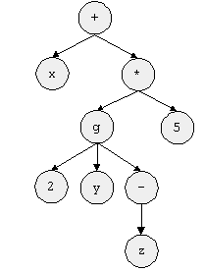
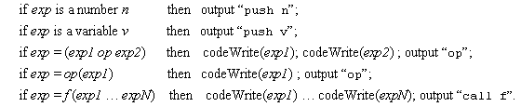

Generating code for expressions
push x
push 2
push y
push z
neg
call g
push 5
call mult
add
Syntax
analysis
Code generation
x+g(2,y,-z)*5
The codeWrite(exp) algorithm:

Slide 18
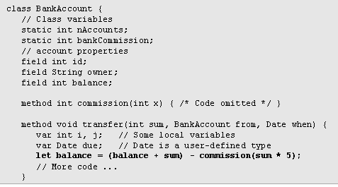
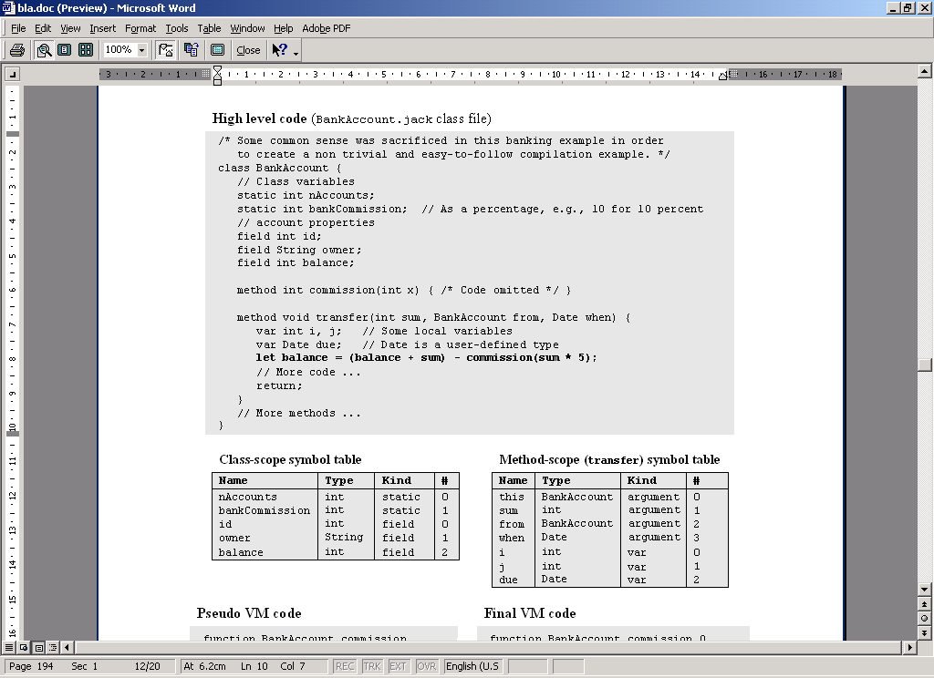
Symbol table
Classical implementation:
A list of hash tables, each reflecting a single scope nested within the next one in the list
The identifier lookup works from the current table upwards.
Notes:
הבעיה: יכולים להיות כמה משתנים עם אותו השם
We need to mind the variable scope
ההיררכיה קובעת שהפנימיים קודמים לחיצוניים
צריך לשמור את ה scope של כל משתנה איכשהו – אופציה אפשרית – list of hash tables
כל אחת מהטבלאות מייצגת scope אחר

Slide 19

Life cycle
Static: single copy must be kept alive throughout the program duration
Field: different copies must be kept for each object
Local: created on subroutine entry, killed on exit
Argument: similar to local
Good news: the VM handles all these details !!! Hurray!!!
Notes:
יש כמה kind למשתנים,
מיפוי המשתנים לסגמנטים הוירטואליים

Slide 20
Handling arrays
RAM state, just after executing bar[k]=19
Java code
0
class Complex {
...
void foo(int k) {
int x, y;
int[] bar; // declare an array
...
// Construct the array:
bar = new int[10];
...
bar[k]=19;
}
...
Main.foo(2); // Call the foo method
...
...
275
x
(local 0)
Bar = new int(n)
Is typically handled by causing the compiler to generate code affecting:
bar = Mem.alloc(n)
276
y
(local 1)
277
4315
bar
(local 2)
Following compilation:
...
504
...
2
k
(argument 0)
4315
4316
4317
19
(bar array)
4318
...
4324
...
VM Code (pseudo)
VM Code (final)
// bar[k]=19, or *(bar+k)=19
push bar
push k
add
// Use a pointer to access x[k]
pop addr // addr points to bar[k]
push 19
pop *addr // Set bar[k] to 19
// bar[k]=19, or *(bar+k)=19
push local 2
push argument 0
add
// Use the that segment to access x[k]
pop pointer 1
push constant 19
pop that 0
Notes:
טיפול במערכים – מערך הוא רצף תאים רציף שמוקצה בזמן ריצה בד"כ. הפוינטר זה כתובת בסיס אליה מוסיפים את המיקום במערך ואז ניגשים. אנחנו צריכים גישה עקיפה. אנחנו משתמשים בסגמנט הזיכרון pointer במיקום 1

Slide 21
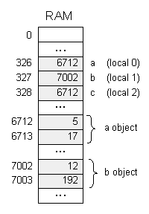
Handling objects: memory allocation
Java code
class Complex {
// Properties (fields):
int re; // Real part
int im; // Imaginary part
...
/** Constructs a new Complex object. */
public Complex(int aRe, int aIm) {
re = aRe;
im = aIm;
}
...
}
// The following code can be in any class:
public void bla() {
Complex a, b, c;
...
a = new Complex(5,17);
b = new Complex(12,192);
...
c = a; // Only the reference is copied
...
}
Following compilation:
foo = new ClassName(…)
Is typically handled by causing the compiler to generate code affecting:
foo = Mem.alloc(n)

Slide 22
Handling objects: operations
Java code
class Complex {
// Properties (fields):
int re; // Real part
int im; // Imaginary part
...
/** Constructs a new Complex object. */
public Complex(int aRe, int aIm) {
re = aRe;
im = aIm;
}
...
// Multiplication:
public void mult (int c) {
re = re * c;
im = im * c;
}
...
}
Translating im = im * c :
Look up the symbol table
Resulting semantics:
// im = im * c :
*(this+1) = *(this+1) times (argument 0)
Of course this should be written in the target language.

Slide 23
Handling objects: method calls
Java code
Translating x.mult(5):
Can also be viewed as mult(x,5)
Generated code:
class Complex {
// Properties (fields):
int re; // Real part
int im; // Imaginary part
...
/** Constructs a new Complex object. */
public Complex(int aRe, int aIm) {
re = aRe;
im = aIm;
}
...
}
class Foo {
...
public void foo() {
Complex x;
...
x = new Complex(1,2);
x.mult(5);
...
}
}
// x.mult(5):
push x
push 5
call mult
General rule: each method call
foo.bar(v1,v2,...)
can be translated into
push foo
push v1
push v2
...
call bar

Slide 24
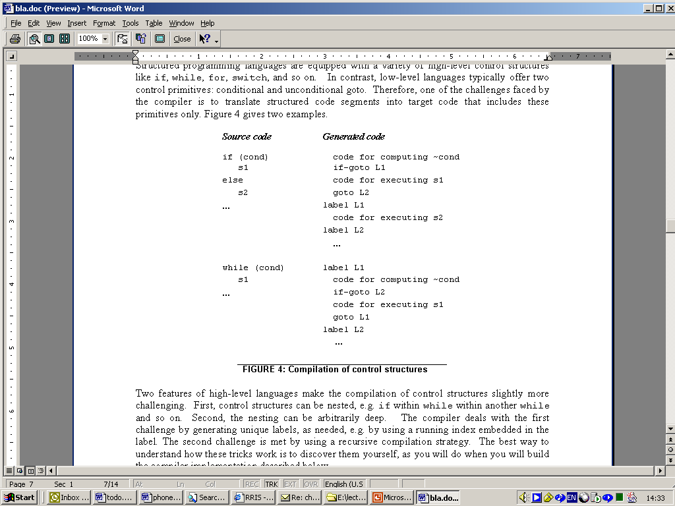
Handling control flow (e.g. IF, WHILE)

Slide 25
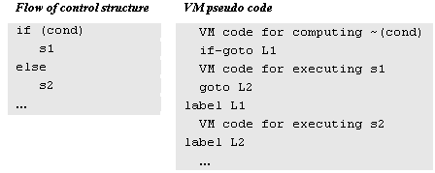

Program flow

Slide 26
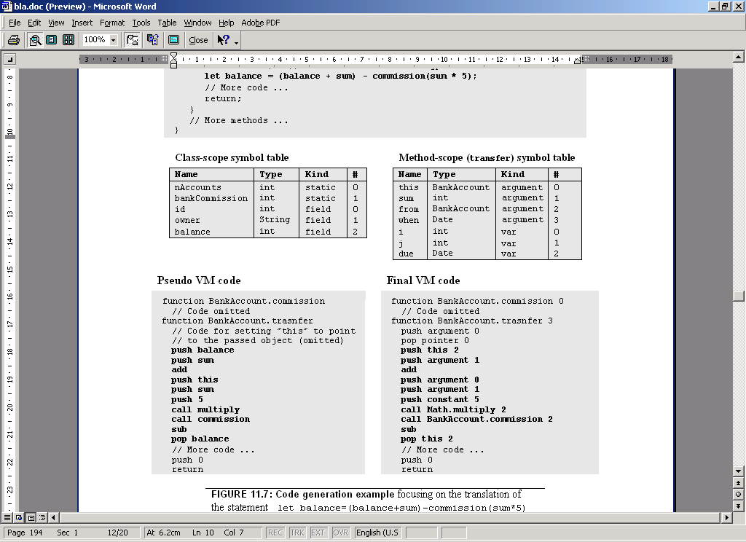
Final example

Slide 27
Perspective
“Hard” Jack simplifications:
Primitive type system
No inheritance
No public class fields (e.g. must use r=c.getRadius() rather than r=c.radius)
“Soft” Jack simplifications:
Limited control structures (no for, switch, …)
Cumbersome handling of char types (cannot use let x=‘c’)
Optimization
For example, c++ will be translated into push c, push 1, add, pop c.
Parallel processing
Many other examples of possible improvements …

